Slide 1
Chapter 7
How to work with images and timers

Slide 2
Objectives
Applied
Preload the images for an application when the images aren’t automatically loaded by the HTTP request for the web page.
Use one-time and interval timers in your JavaScript applications.
Knowledge
Describe the use of images and preloaded images in applications like image swaps and slide shows.
Describe these timer methods: setTimeout(), clearTimeout(), setInterval(), and clearInterval().

Slide 3
Some attributes of the HTML img element
src
alt
width
height

Slide 4
How to create an HTMLImageElement object
const image = new Image();
How to preload an image
const image = new Image();
image.src = "image_name.jpg";
How to preload all images referenced by the href attributes of <a> tags
const links = document.querySelectorAll("a");
for ( let link of links ) {
const image = new Image();
image.src = link.href;
}

Slide 5
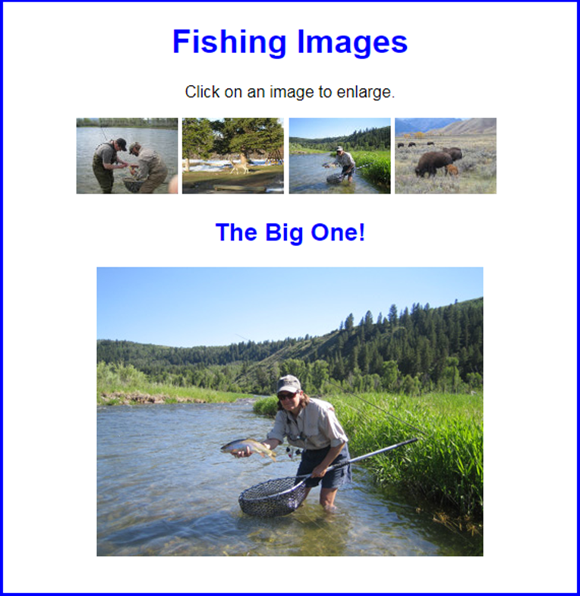
The Image Swap application

Slide 6
The HTML for the main element of the Image Swap application
<main>
<h1>Fishing Images</h1>
<p>Click on an image to enlarge.</p>
<ul id="image_list">
<li><a href="images/release.jpg"
title="Catch and Release">
<img src="thumbnails/release.jpg"
alt="release fish"></a></li>
<li><a href="images/deer.jpg" title="Deer at Play">
<img src="thumbnails/deer.jpg" alt="deer"></a></li>
<li><a href="images/hero.jpg" title="The Big One!">
<img src="thumbnails/hero.jpg" alt="big fish"></a></li>
<li><a href="images/bison.jpg" title="Roaming Bison">
<img src="thumbnails/bison.jpg" alt="bison"></a></li>
</ul>
<h2 id="caption">Catch and Release</h2>
<p><img id="main_image" src="images/release.jpg"
alt="release fish"></p>
<script src="image_swap.js"></script>
</main>

Slide 7
The CSS for the li elements
li { display: inline; }

Slide 8
The JavaScript for the Image Swap app (part 1)
const $ = selector => document.querySelector(selector);
document.addEventListener("DOMContentLoaded", () => {
const caption = $("#caption"); // the h2 element
const mainImage = $("#main_image"); // the main img element
// get all the <a> tags in the ul element
const imageLinks = $("#image_list").querySelectorAll("a");
// process image links
for ( let link of imageLinks ) {
// preload image
const image = new Image();
image.src = link.href;

Slide 9
The JavaScript for the Image Swap app (part 2)
// attach event handler
link.addEventListener("click", evt => {
// set new image and caption
mainImage.src = link.href;
mainImage.alt = link.title;
caption.textContent = link.title;
// cancel the default action of the event
evt.preventDefault();
});
}
// set focus on first image link
imageLinks[0].focus();
});

Slide 10
Two methods for working with a timer that calls a function once
setTimeout(function,delay)
clearTimeout(timer)

Slide 11
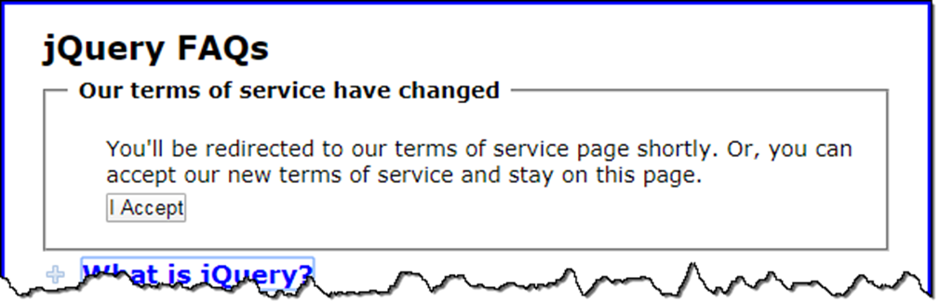
An application that redirects after 5 seconds if a button isn’t clicked

Slide 12
The HTML for the terms of service message
<fieldset id="terms">
<legend>Our terms of service have changed</legend>
<p>You'll be redirected to our terms of service page
shortly. Or, you can accept our new terms of
service and stay on this page.</p>
<p><input type="button" id="accept"
value="I Accept"></p>
</fieldset>
A CSS class to hide an element
.hidden { display: none; }

Slide 13
How to use a one-time timer to perform or cancel the redirection
// declare a variable to hold the reference to the timer;
// make it global so all the functions can access it
let timer = null;
const goToTerms = () =>
window.location.href = "terms.html";
const acceptTerms = () => {
// code to accept terms goes here
clearTimeout( timer );
$("#terms").setAttribute("class", "hidden");
};
document.addEventListener("DOMContentLoaded", () => {
...
timer = setTimeout( goToTerms, 5000 );
$("#accept").addEventListener("click", acceptTerms);
...
});

Slide 14
Two methods for working with a timer that calls a function repeatedly
setInterval(function,interval)
clearInterval(timer)

Slide 15
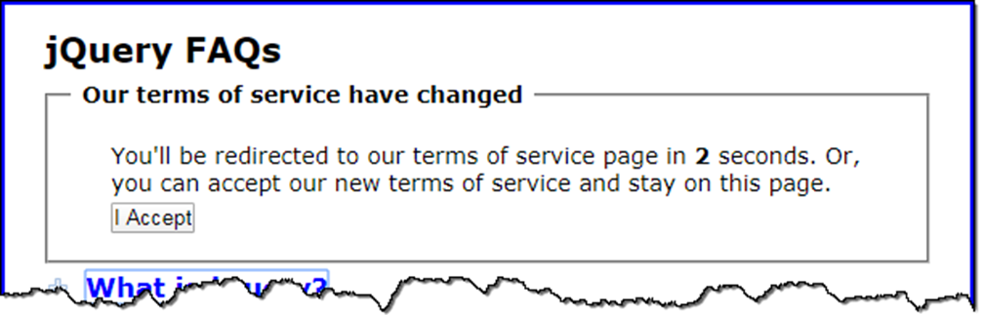
The application updated to count down to the redirection
The updated HTML for the terms of service message
<p>You'll be redirected to our terms of service page in
<b><span id="seconds">5</span></b> seconds. Or...</p>

Slide 16
The updated code that uses an interval timer
// create global variables to hold the timer and the current count
let timer = null;
let counter = 5;
const goToTerms = () => {
counter--; // decrement counter
if (counter == 0) {
window.location.href = "terms.html"; }
else {
$("#seconds").textContent = counter; } // update seconds
};
const acceptTerms = () => {
// code to accept terms goes here
clearInterval( timer );
$("#terms").setAttribute("class", "hidden");
};
document.addEventListener("DOMContentLoaded", () => {
...
timer = setInterval( goToTerms, 1000 );
$("#accept"). addEventListener("click", acceptTerms);
...
});

Slide 17

The Slide Show application

Slide 18
The HTML for the Slide Show application
<main>
<h1>Fishing Slide Show</h1>
<ul id="image_list">
<li><a href="images/release.jpg"
title="Catch and Release"></a></li>
<li><a href="images/deer.jpg"
title="Deer at Play"></a></li>
<li><a href="images/hero.jpg"
title="The Big One!"></a></li>
<li><a href="images/bison.jpg"
title="Roaming Bison"></a></li>
</ul>
<p><img id="main_image" src="images/release.jpg"
alt="Catch and Release"></p>
<h2 id="caption">Catch and Release</h2>
<script src="slide_show.js"></script>
</main>

Slide 19
The CSS for the ul element
ul { display: none; }

Slide 20
The JavaScript for the Slide Show app (part 1)
const $ = selector => document.querySelector(selector);
document.addEventListener("DOMContentLoaded", () => {
const caption = $("#caption"); // the h2 element
const mainImage = $("#main_image"); // the img element
// get all the <a> tags in the ul element
const links = $("#image_list").querySelectorAll("a");
// process image links
const imageCache = [];
let image = null;
for ( let link of links ) {
// preload image and copy title properties
image = new Image();
image.src = link.href;
image.alt = link.title;
// add image to array
imageCache[imageCache.length] = image;
}

Slide 21
The JavaScript for the Slide Show app (part 2)
// start slide show
let imageCounter = 0;
setInterval( () => {
// calculate the index for the current image
imageCounter = (imageCounter + 1) % imageCache.length;
// get image object from array
image = imageCache[imageCounter];
// set HTML img and h2 elements
// with values from image object
mainImage.src = image.src;
mainImage.alt = image.alt;
caption.textContent = image.alt;
},
2000); // 2 second interval
});

